Slide 1
Modifiers based on Connectives
FSTA 2012

Slide 2



Pliant system (negation)

Slide 3
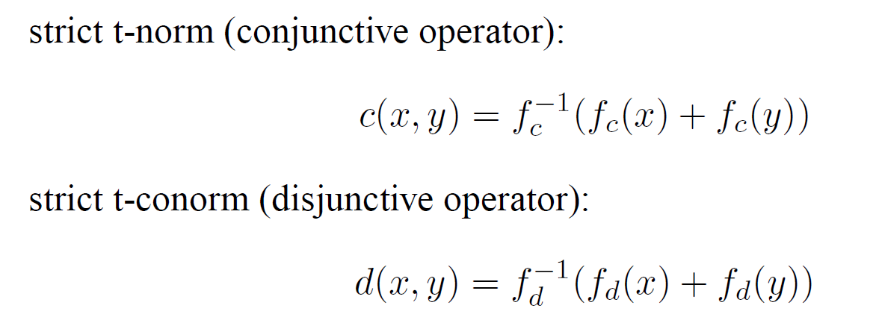


Pliant system (t-norm, t-conorm)

Slide 4
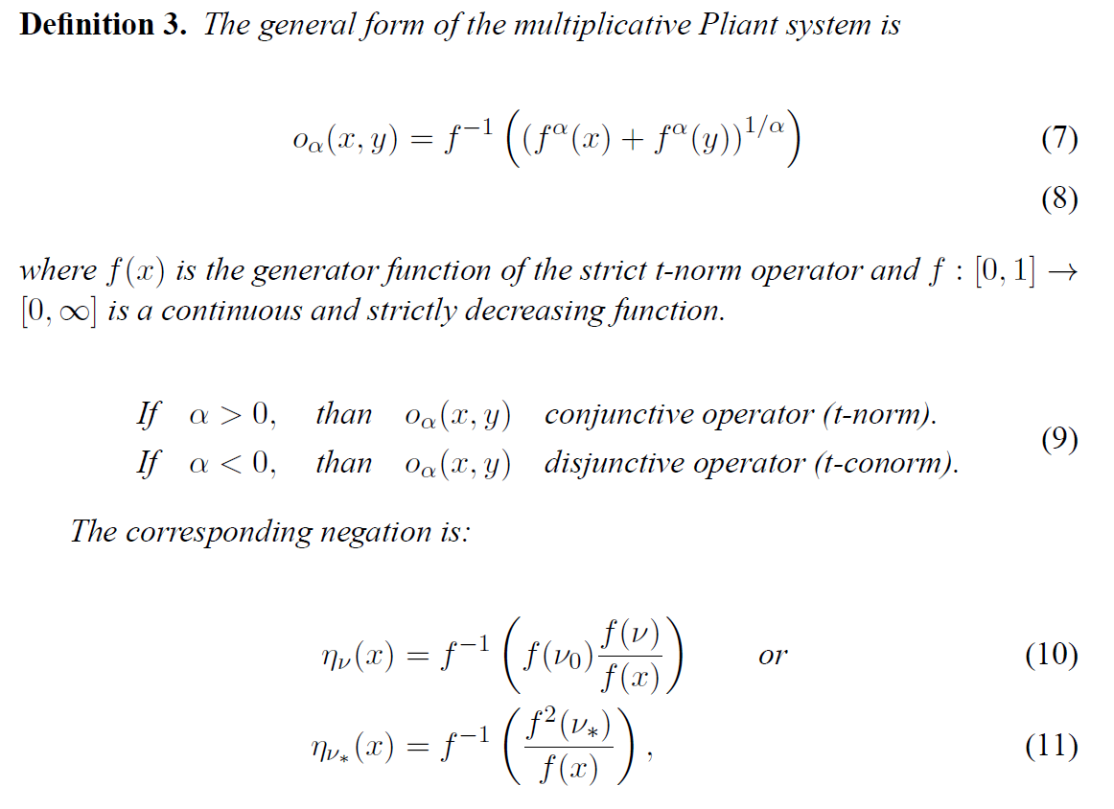
Pliant system

Slide 5
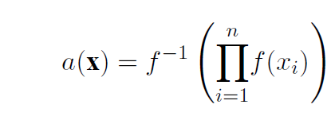
Pliant operator (uninorm)

Slide 6
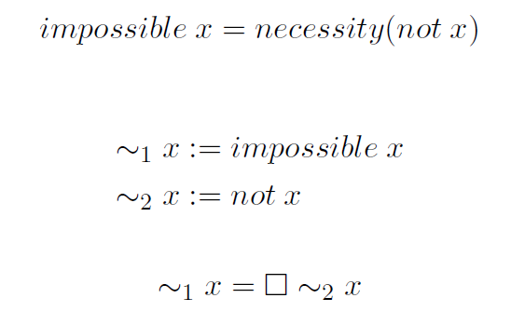



Modalities induced by two negations

Slide 7
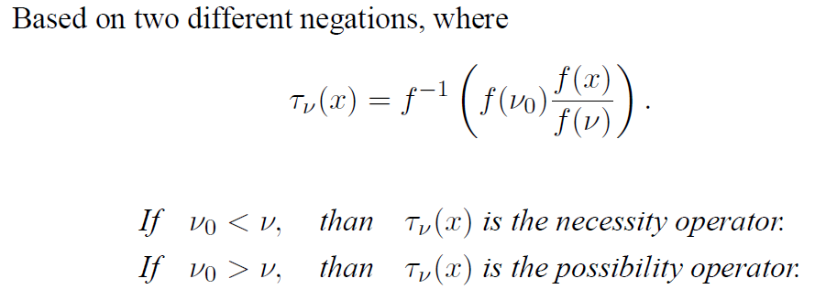
Modalities induced by two negations

Slide 8
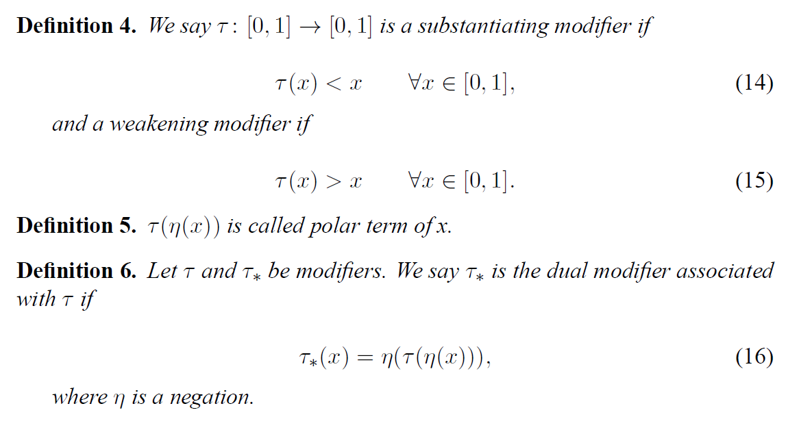
Hedges

Slide 9
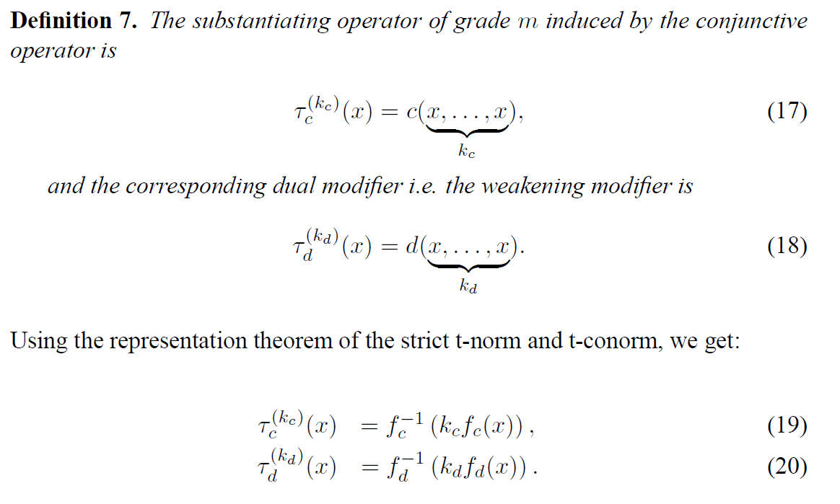
Hedges

Slide 10
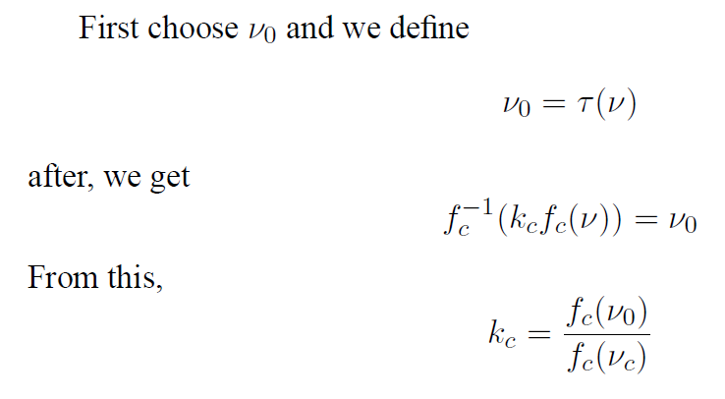
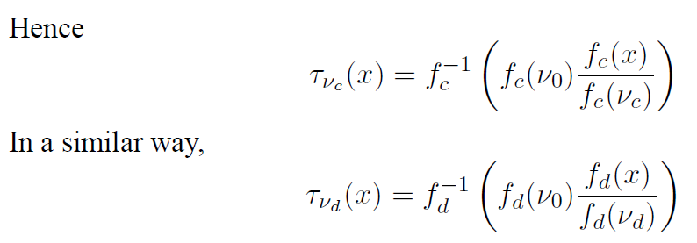
Hedges

Slide 11
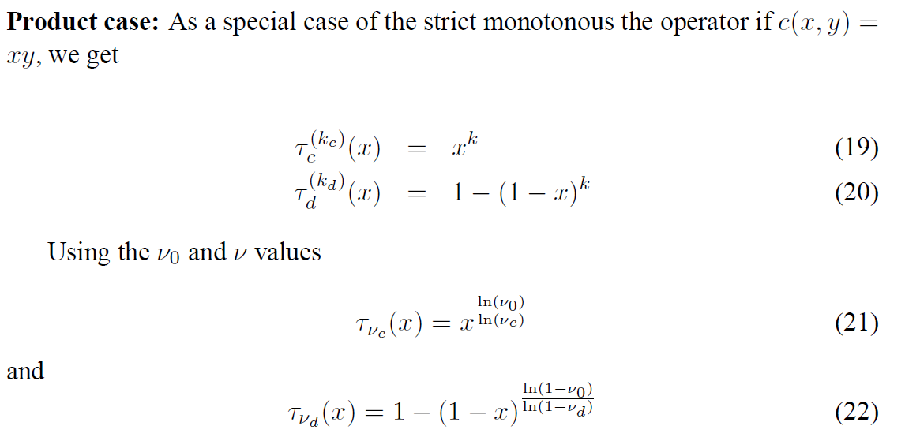
Hedges (special cases)

Slide 12



The equivalence of conjunctive and disjunctive hedges

Slide 13


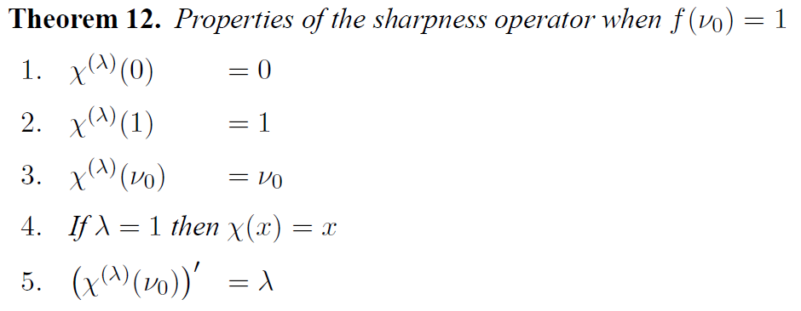
Sharpness operator

Slide 14
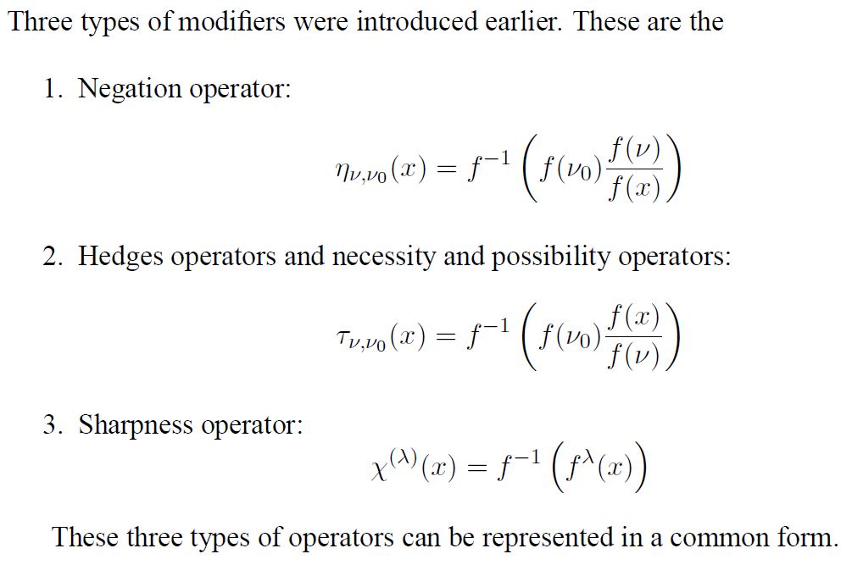
General form of modifiers

Slide 15
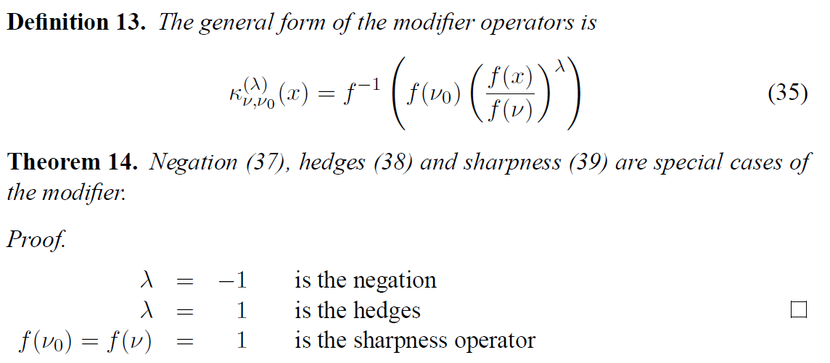
General form of modifiers

Slide 16
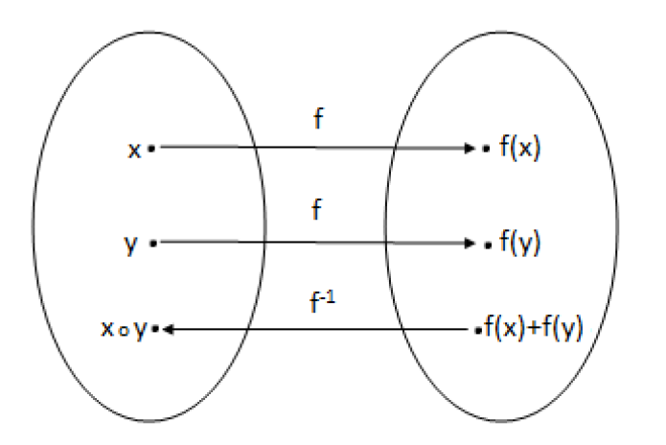
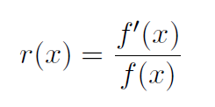

Modifiers characterized by a differential equation

Slide 17


Modifiers characterized by a differential equation

Slide 18
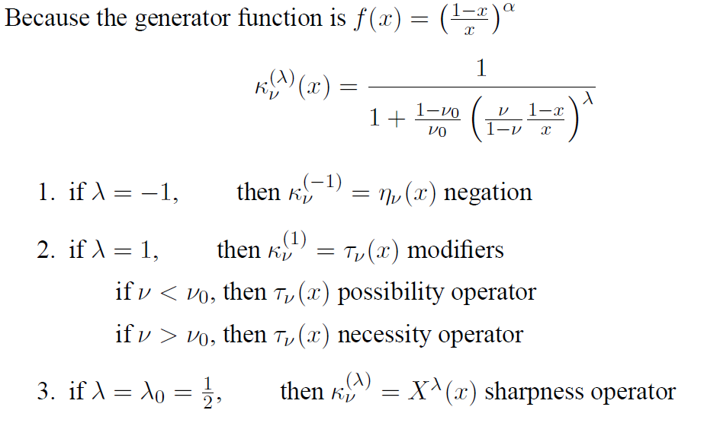
The Dombi operator case

Slide 19
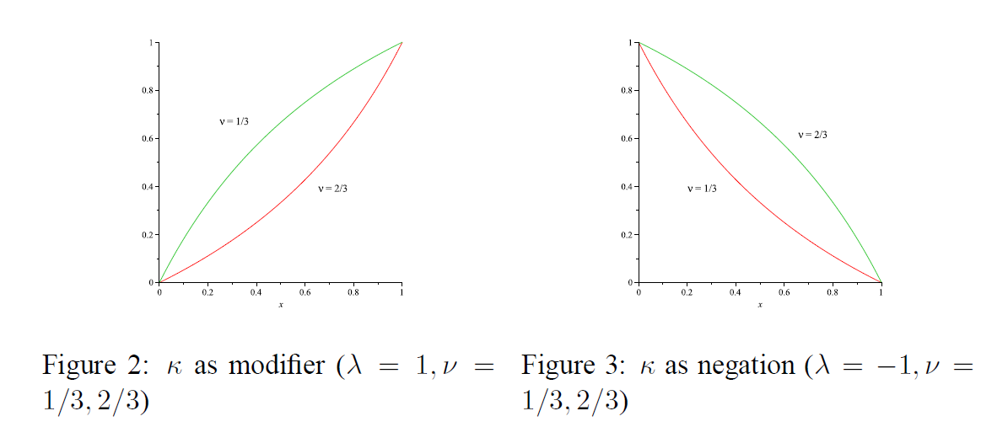
Figures

Slide 20
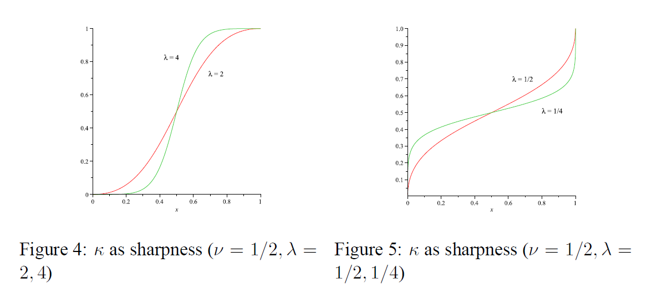
Figures

Slide 21
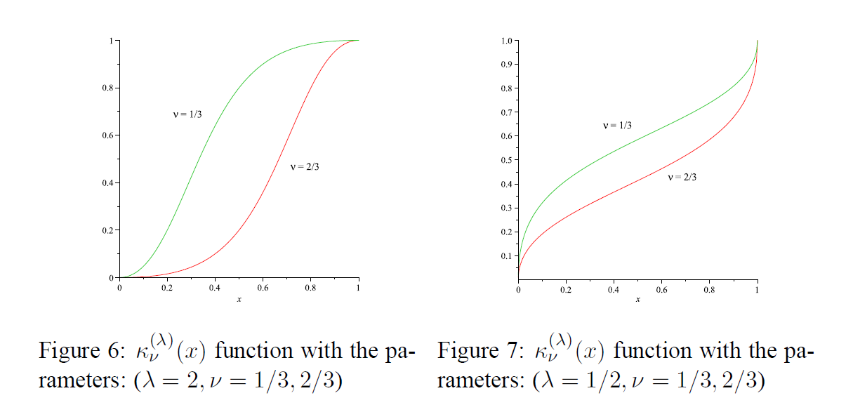
Figures

Slide 22
Thank you for your attention!

